Slide 1

BBA 3rd SEM
Session (2023-24) Warren Buffett
Submitted by- Divy Jain Pakhi Yadav Ritika Solanki Shankh Bansal
Submitted to -
Mr. L.J. Brown

Slide 2

Index
Introduction
Childhood Phase
Buffett Struggle
Conclusion

Slide 3
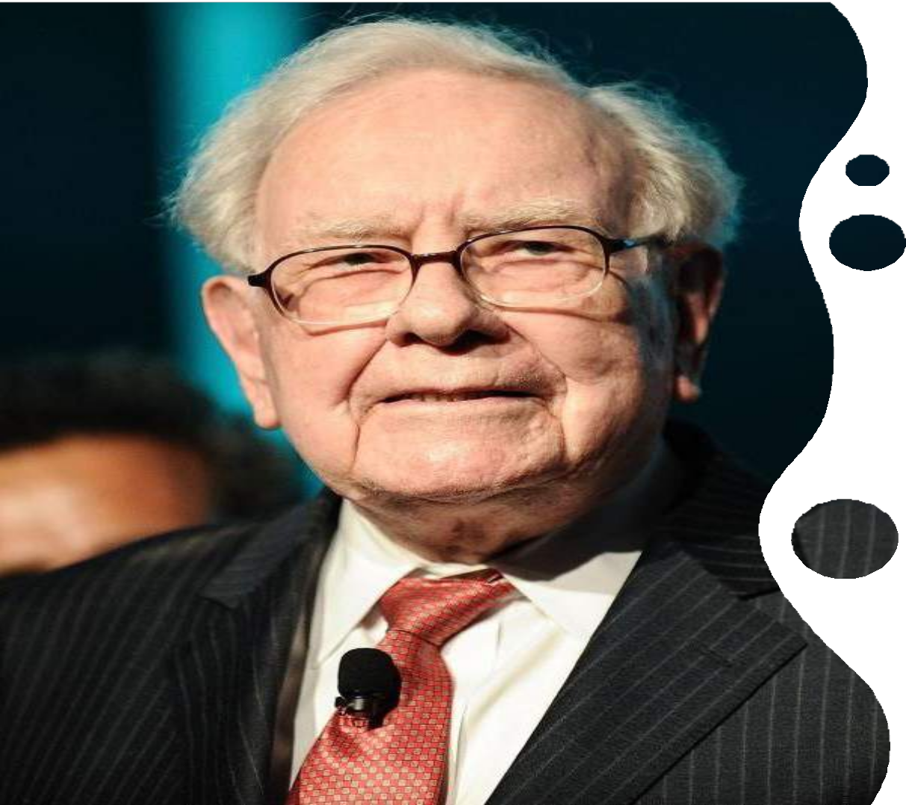
General Information
•• Warren Buffett, in full Warren Edward Buffett, He is
born on August 30, 1930, Omaha, Nebraska, U.S.)
••He was an American businessman and philanthropist.
••Buffett was the son of U.S. Representative Howard Homan Buffett from Nebraska. After graduating from the University of Nebraska (B.S., 1950
This Photo by Unknown author is licensed under CC BY-NC-ND.

Slide 4
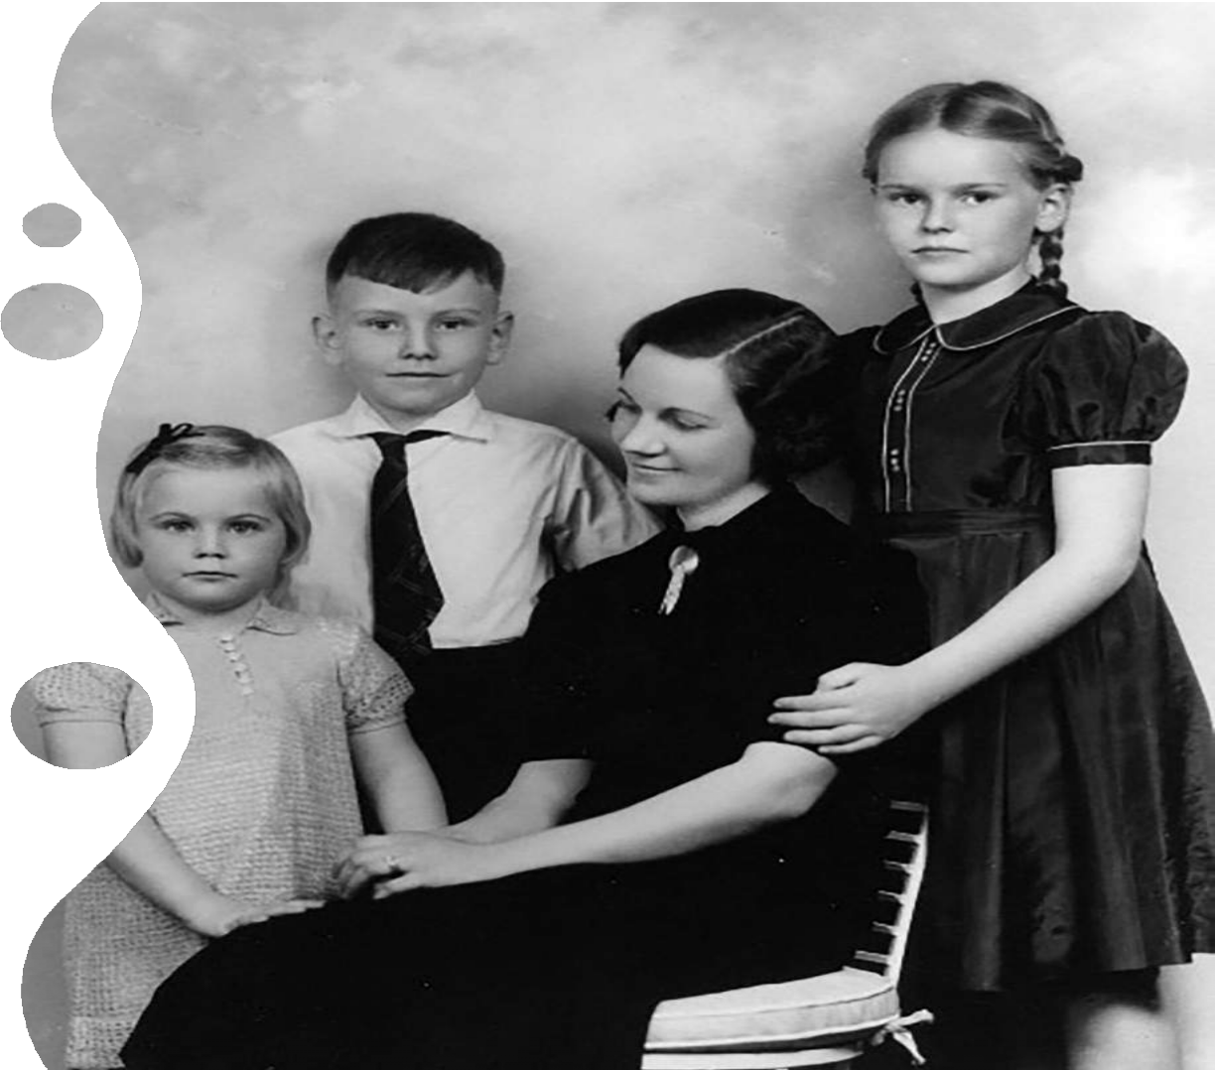
Early life
Warren Buffett was one of the three children of Howard and Leila Buffett. He had two sisters. His
father was a four-term U.S. congressman.
He started his education at Rose Hill Elementary School before shifting to Alice Deal Junior High
School. He graduated from Woodrow Wilson High
School in 1947.
He had an acute business sense even as a small child; he used to earn money by selling chewing gum and soft drinks. As a teenager, he became involved in a number of money-making ventures and also started saving and investing his money.

Slide 5
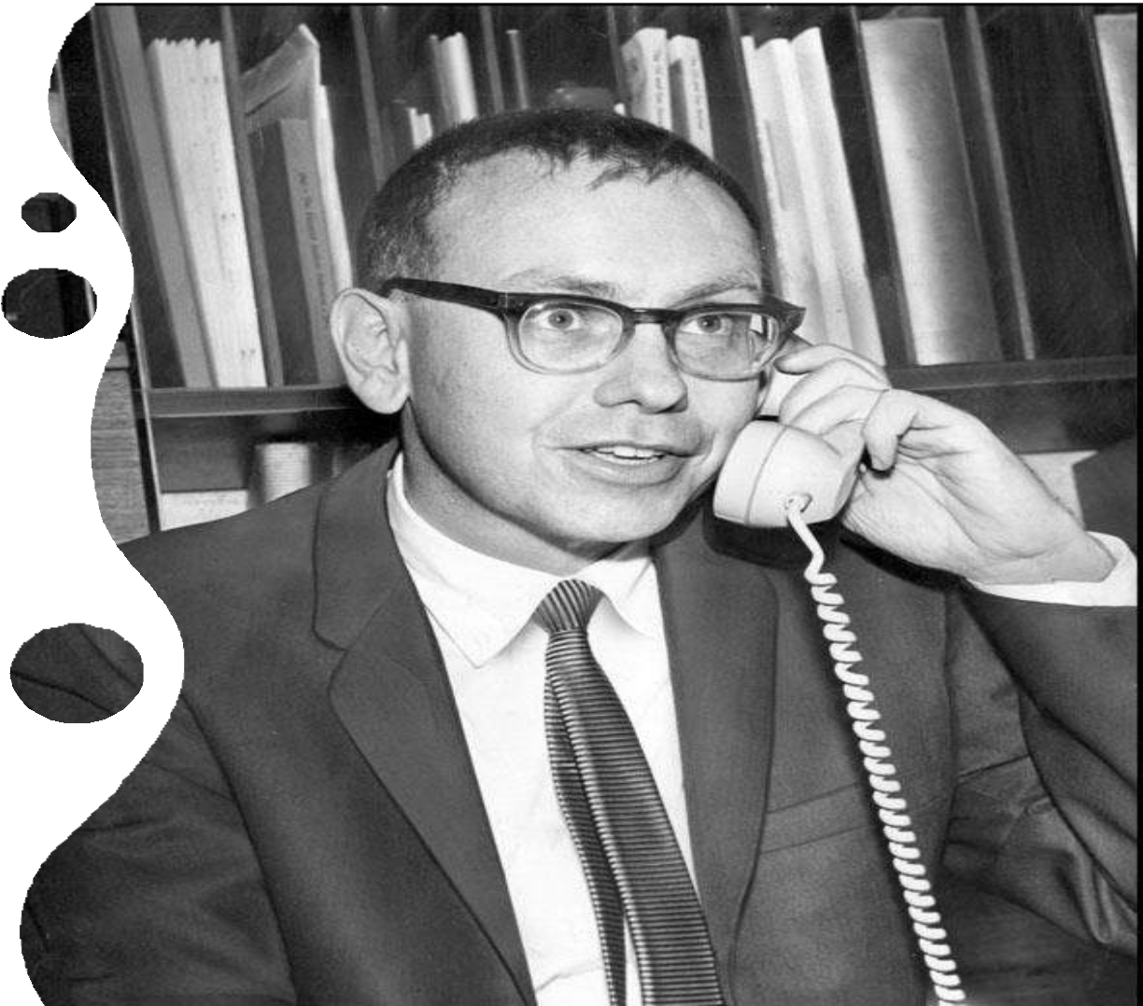
Schooling Life
Warren Buffett enrolled at the Wharton School of the University of Pennsylvania in 1947,
where he studied for two years. He shifted to the University of Nebraska–Lincoln from where he graduated with a Bachelor of Science in business administration.
•Warren attended Columbia Business School and earned a Master of Science in economics
in 1951. There he had the privilege of
attending classes taught by Benjamin Graham
and David Dodd.

Slide 6
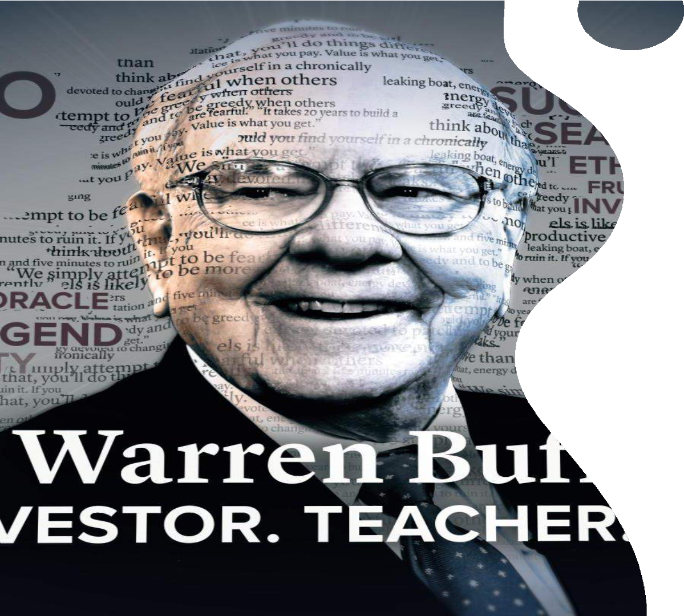
As an early Investor.
Republican congressman.﻿ Buffett ran away once.﻿ He bought his first stock, Cities Service Preferred, at $38 a share. It dropped to $27 a share, but then rose back to $40, at which point Buffett sold. Cities subsequently rose to $200 a share.
From the 1960s through the ’90s the major stock averages rose by roughly 11 percent annually, but Berkshire Hathaway’s publicly traded shares gained about 28 percent per year.

Slide 7
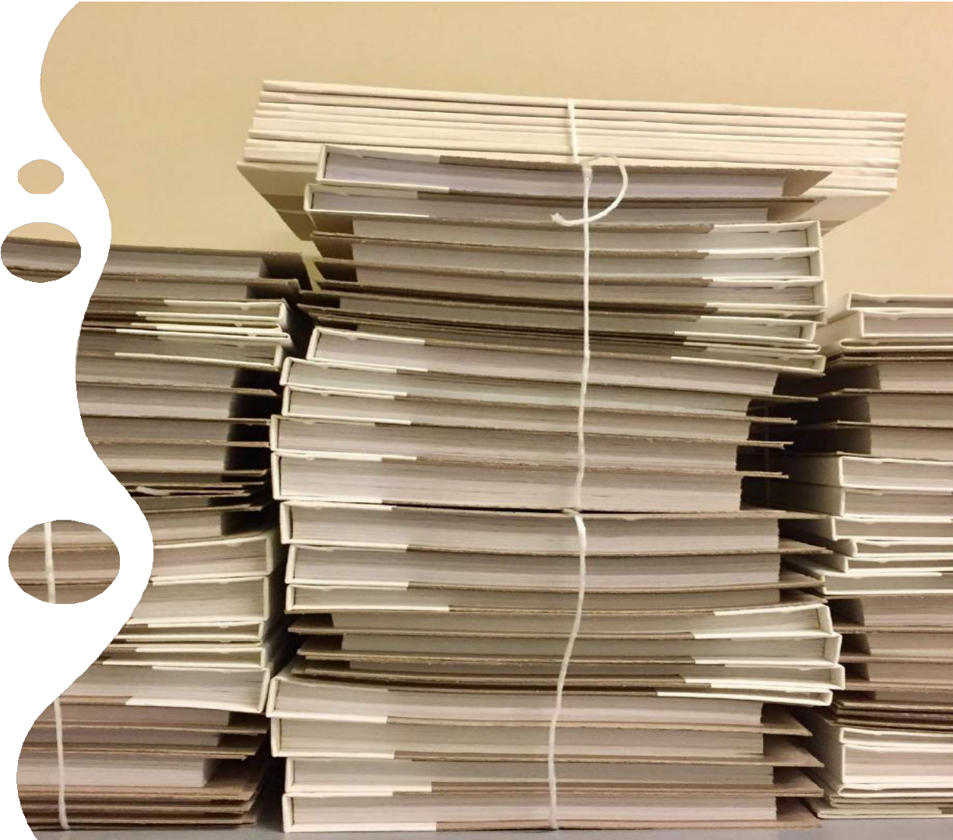
Paper Route
One of Buffett's first jobs was as a delivery boy for the Washington Post.
﻿Even with 500 papers to deliver, the process was so efficient that it only took a little more
than an hour.
﻿Buffett expanded into magazines, and eventually was earning $175 a month.
﻿Buffett refused to let his dad pay the taxes.
Instead, Buffett tracked his earnings and filed his own return

Slide 8
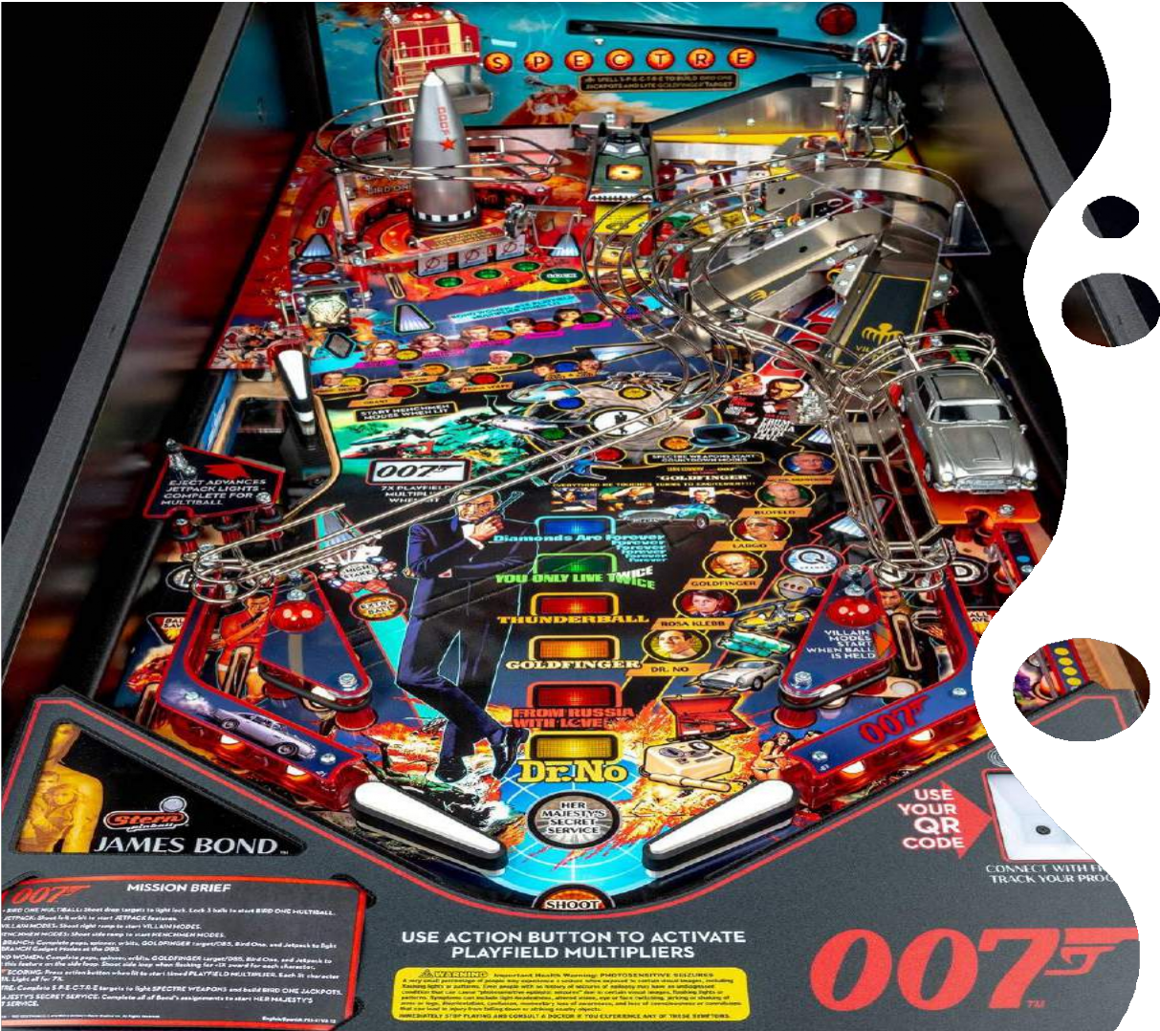
Pinball Machine business
As a high school senior, Buffett and a friend began
buying used pinball machines and putting them in barbershops.
Buffett: "Eventually we were making $50 a week. I hadn't dreamed life could be so good."
But the pinball machines were constantly breaking, and the barbershop owners kept pushing them to
put in new machines.
"We'd always tell them we'd take it up with the boss. We pretended like we were these hired hands that were carrying machines around and counting
money."

Slide 9
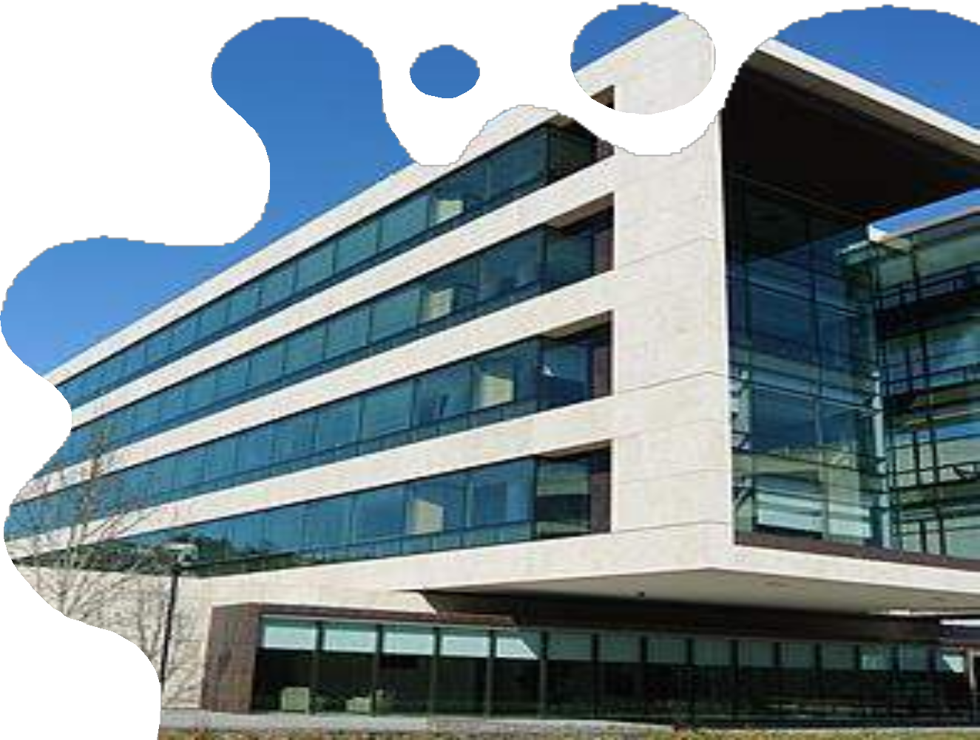

Buffett Associates Ltd
In 1956 Buffett started an investment
partnership.
Raised $105,000 from family and friends. Results: earned more than
30% annually from 1956 to 1969, when the general market earned only about 8% annually.
Began to consult with Charlie Munger.
In May 1969, he dissolved the
partnership, as he was
"unable to find any bargains in the
current market".
This Photo by Unknown author is licensed under CC BY-SA.

Slide 10
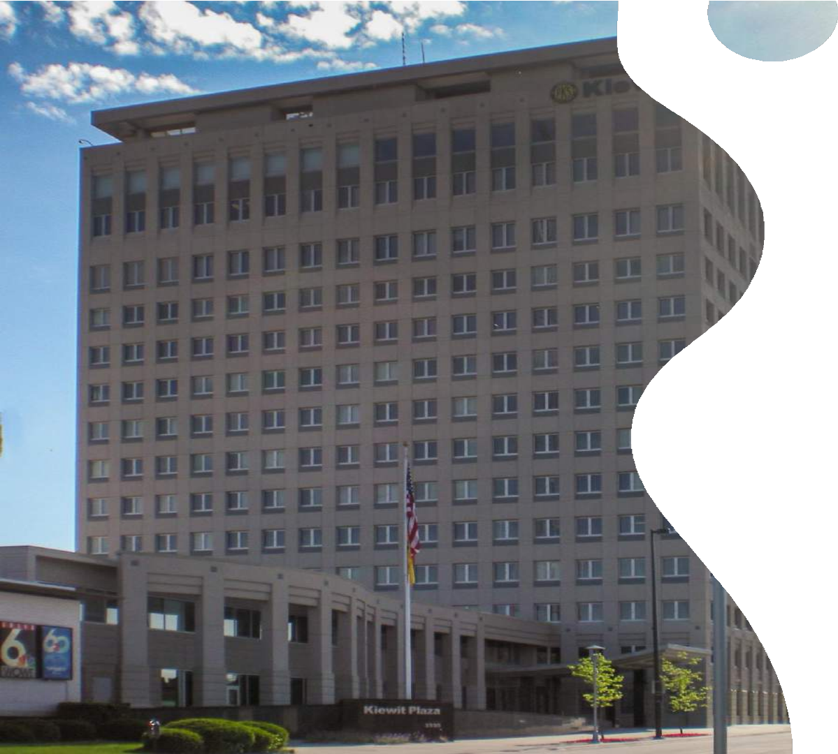
Berkshire Hathaway
Warren Buffett didn't found his company, but took control of
it in 1965, when he was 35 years old.
Berkshire Hathaway, Inc. is actually an insurance company; Buffett just invests the money for the company instead of putting it in a bank, increasing their profits many times over.
Berkshire Hathaway actually started as a textile company in
1929 when Valley Falls Company merged with Berkshire Fine Spinning
Associates.
One of the businesses the company owns (they have
bought 100% of the company's stock) is the well-known Geico Company.

Slide 11
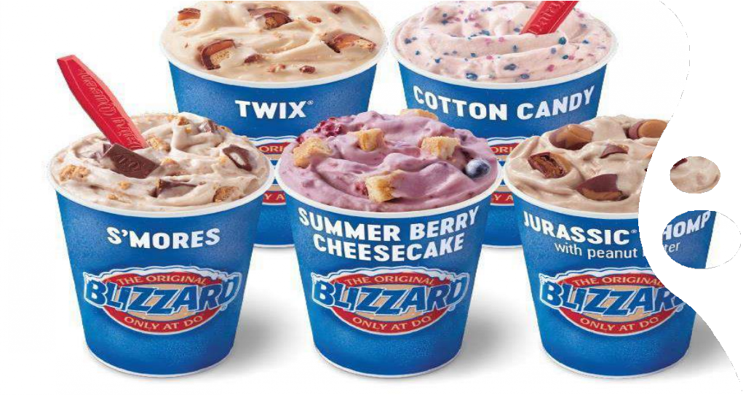
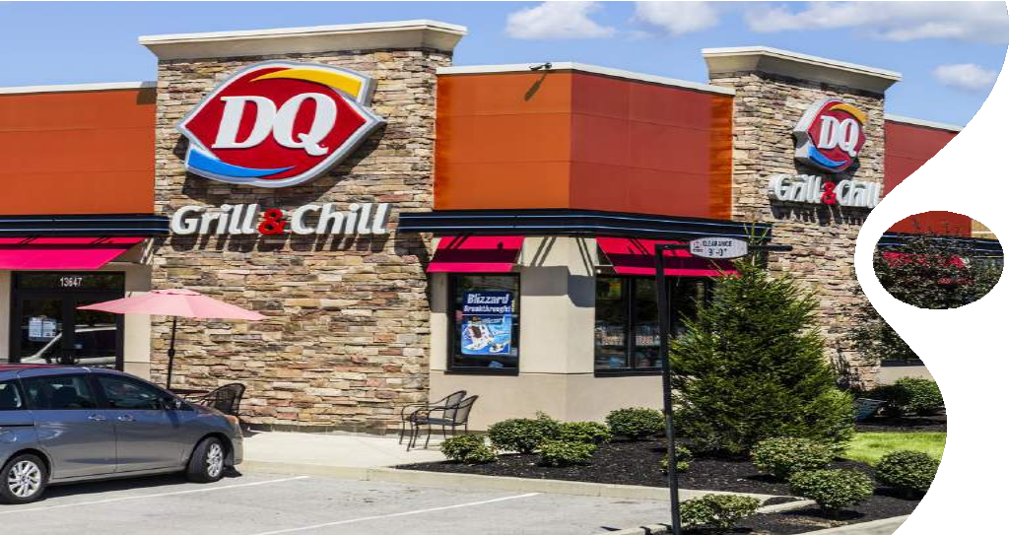
Dairy Queen
One of the companies owned by Berkshire Hathaway is Dairy Queen.
Dairy Queen, as we all know, makes the regular fast food
things - burgers, fries, and chicken nuggets.
However, what sets Dairy Queen apart from McDonald's, Burger King, and Wendy's is what it is known for; it has a good variety - and good quality - of ice cream,
milkshakes, and other things like that.

Slide 12
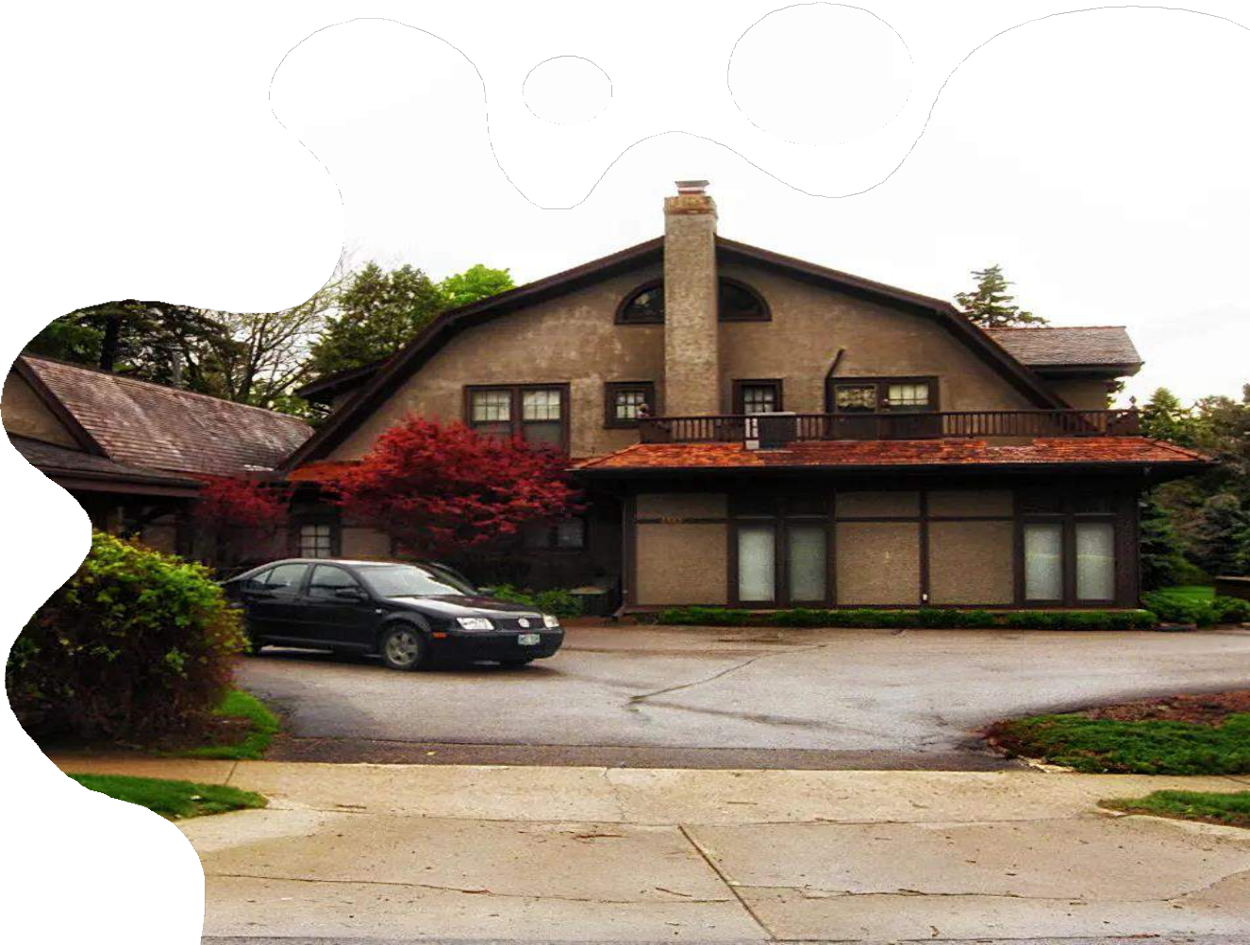
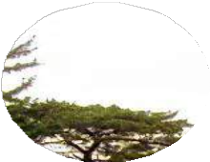
Tenets of Warren Buffett!
Understandable Businesses
Favorable Long-term Prospects
Good Management
Buy at an Attractive Price

Slide 13
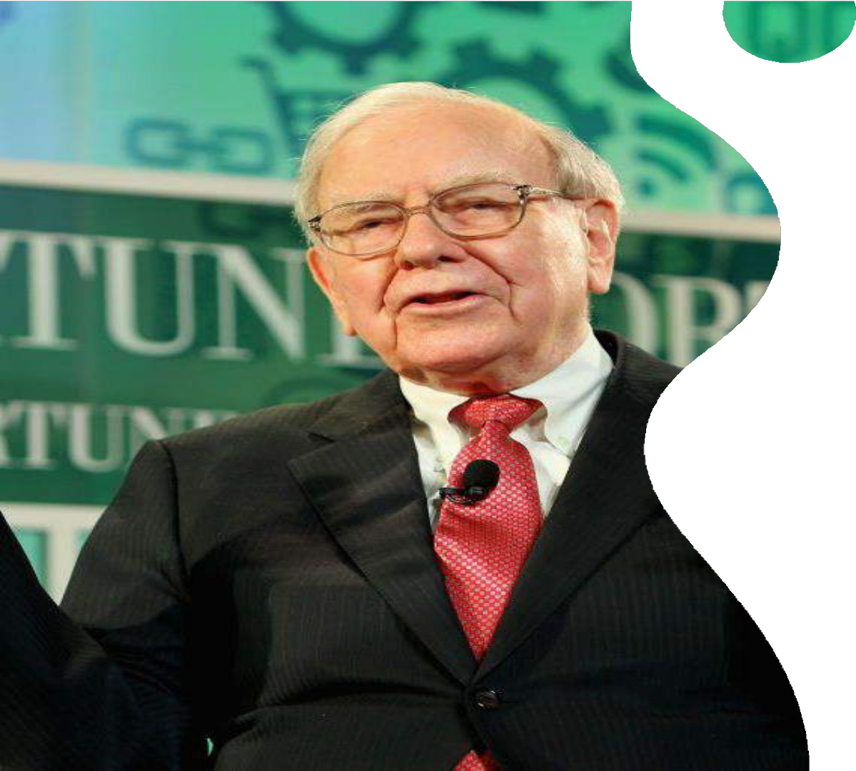
Conclusion
Warren Buffett has become one of the most successful and respected investors in the world. He is known for his long- term investment strategies, value-oriented approach, and shrewd business acumen.
Throughout his life, Buffett amassed a significant fortune through his company, Berkshire Hathaway, which he transformed from a struggling textile manufacturer into a diversified conglomerate with investments in various industries. His success in the stock market and his ability to identify undervalued companies have made him a billionaire and earned him the nickname "Oracle of Omaha."

Slide 14
Warren Buffett has been an influential figure in the finance world, often sought after for his investment advice and insights. He is known for his frugal lifestyle and commitment to philanthropy. Buffett has pledged to give away the majority of his wealth to charitable causes, primarily through the Bill & Melinda
Gates Foundation. His life and investment philosophy continue to inspire and influence generations of investors and business leaders who seek to learn from the wisdom of this iconic financial guru

Slide 15
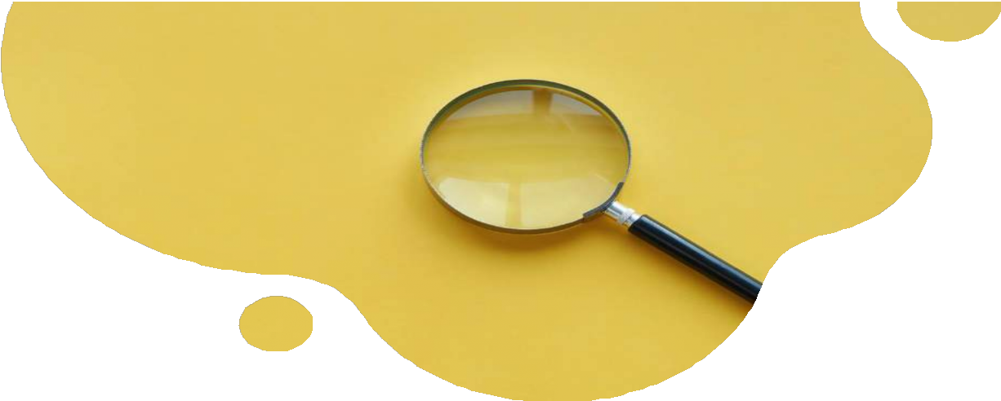

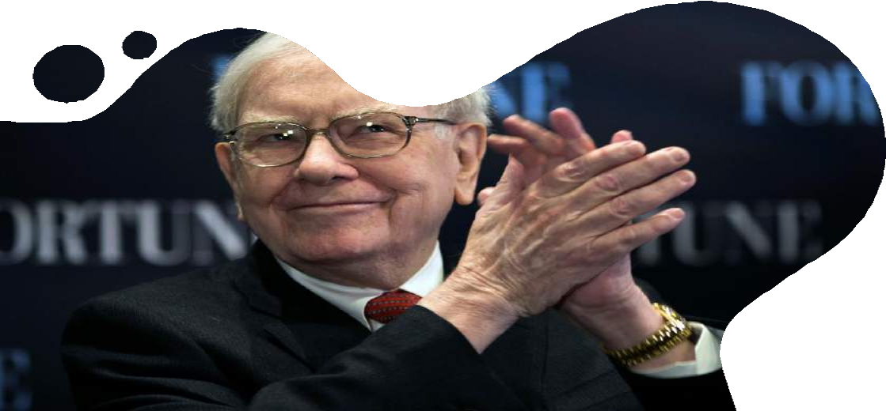
Thank You
"The most important investment you can make is in yourself"

